Slide 1

Information Security Awareness
Document Ref. ID | ISMS-WRK-037
Issue | 1.2
Issue date | 10/11/2021
Status
Confidential Level | Internal Use

Slide 2
Contents
Why Security?
What Security Are?
Security Definition
Security Threats, Risks and example of Violation
Where/Who/When Security is Applied?
Security Control and Discipline Policy
Best Practices
Appendix
How to Implement & Apply Security?
Security System and Elements
Roles & Responsibilities
Policies, Guidelines & Regulations

Slide 3
Why Security? (1/3)
Why a customer choose an IT Outsourcing Company? What they need from us?
Scenario 1: Management discussion of customer:
Boss: Why we choose this ITO Company instead of building our in-house IT teams?
Staff: Because of reason a, b, c…
Boss: Sound good. But what if they don’t keep secret for our new product that not being yet on the market?
Staff: …
-> Customer really needs an IT Outsourcing company to keep information security to their product/intellectual property.

Slide 4
Why Security? (2/3)
Why a customer choose an IT Outsourcing Company? What they need from us?
Scenario 2: Management discussion of customer:
Boss: How about our current ITO Company vendor?
Staff: All good, quality and 100% information security ensure.
Boss: Sound good. Going more with them, even let them join our server room/production. I can’t wait for our new product.
-> More information security, more trust from customer, more business opportunity we get.

Slide 5
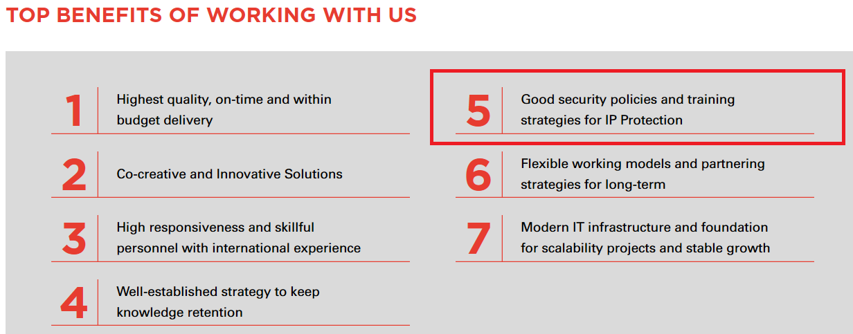
Why Security? (3/3)
The 2 scenarios above are few of the answers for Why Security question.
Security is one of the survival factors of an ITO Company (then affected to each staff, surely).
Home page of our website focused on the important of security

Slide 6
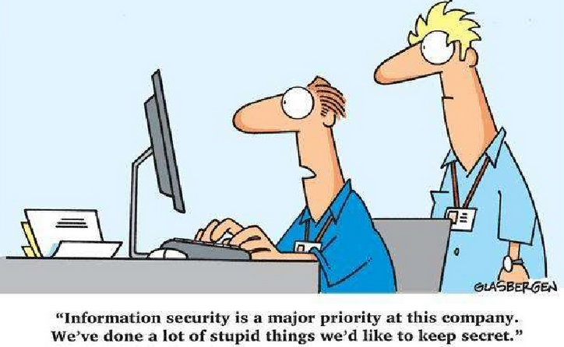
Tea Break: change the word “stupid” by “innovation” or “new trend technology”… for below:

Slide 7
What Security Are?
Security Definition
Security Threats, Risks and example of Violations

Slide 8
What Security Are? (1/2)
Security Definition:
Asset or Intellectual Property (IP) of our company and customer, including but not limited to:
Information: Source code, working documents, accounts…
Hardware: devices, products of customer/company for working
-> Security is to keep all assets or IPs of customer/company confidential, integrity, availability.

Slide 9
What Security Are? (2/2)
Security Threats, Risks and example of Security Violation:
Threat | Risk | Violation Example
Human mistakes/un-awareness | Leak Intellectual Property of customer or company (Customer disappointed, loss company reputation) | Storing source code, working documents… of customer/company at wrong storage, ex: public Github, BitBucket, Public Drive…
Human intention/hacking | Leak Intellectual Property of customer or company (Customer disappointed, loss company reputation) | + Using source code, working documents… of customer/company for personal purpose. + Copying code on internet without permission/license for using when working at company.
Technical failure | Poor quality, less secure productivity | + No security standard coding + Un-secured account info, admin info
… | … | …

Slide 10
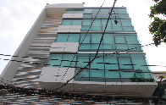


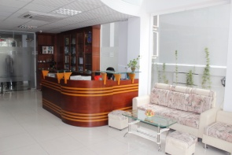
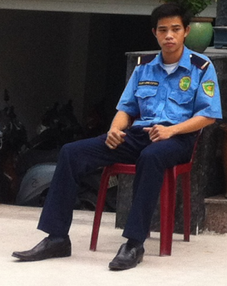

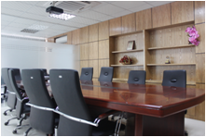

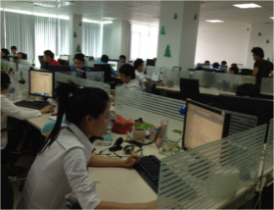
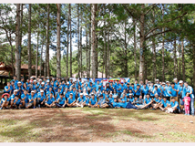
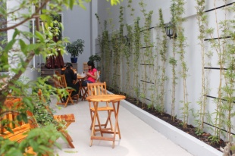
Where/Who/When Security is Applied?
Every place
Everyone
Every minute, & second

Slide 11
Security control and discipline policy (1/2)
Security controls that applied in company:
1- Legal requirement:
All staffs are requested to Read, Understand, Sign and Comply with:
+ NON-DISCLOSURE AGREEMENT (NDA)
+ INDIVIDUAL SECURITY AGREEMENT
2- Operation security requirement:
All staffs are requested to follow Security Policy, Process, Procedure of company and customer in daily operation.
3- Security Awareness requirement:
All staffs are requested to always develop Security Mindset by qualification/learning, join and pass Security Awareness Training Course of company.

Slide 12
Security control and disciplinary policy (2/2)
Incase of security violated, what is the company’s disciplinary policy?
Disciplinary Level | Actions | Violation Example
Warning | Warning the staff not to repeat the non-compliance | + Unexpected non-compliance, no bad purpose. + Non/minor impact to company/customer
Punishment | BOD to consider case by case, not limited to below: + Financial compensation + Labor contract suspension | + Intensively steal IP of company/customer for bad purpose. Violated NDA. + Caused minor impact to company/customer.
Request legal help | Request legal help to protect asset, intellectual property (IP) of company/customer | + Intensively steal IP of company/customer for bad purpose. Violated NDA. + Caused seriously impact to company/customer.

Slide 13
Best Practices
Some should DO and DO NOT
Do | Do Not
Always raise security mindset for any actions relative to Intellectual Property of customer/company | Keep or store Asset or Intellectual Property of customer/company in un-permitted storage: public Github, Bitbucket, public Drive…, personal Drive, CD, Cabinet…
Feel free to ask your PM if having any concern/contribution about security violating or not. (also can contact IT for this. Skype: S3.ITSupport or mail it@s3corp.com.vn) | Share Asset or Intellectual Property of customer/company for unexpected parners/personel or with an un-secured method, ex: public, no permission control.
Think about the Code of Conduct for our professional career | Take Asset or Intellectual Property of customer/company for personal purpose. Or, use any IP rights of third party without consent of customer/company.

Slide 14
Appendix
How to Implement & Apply Security?
Security System and Elements
Roles & Responsibilities
Policies, Guidelines & Regulations

Slide 15
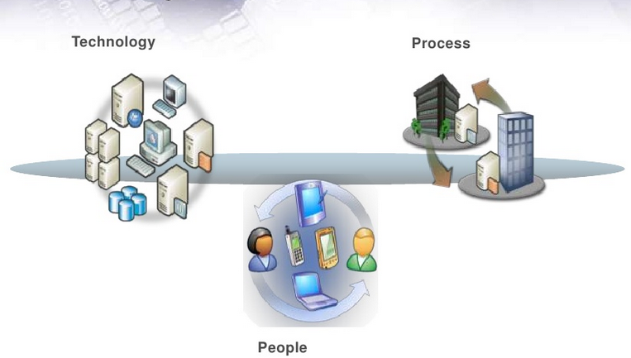
Appendix - How to Implement & Apply Security?
Security System
Security system addresses all kind of security threats
Security system involves all stakeholders to follow: employees, partners, customers, suppliers, guests, etc
Notes:
15

Slide 16
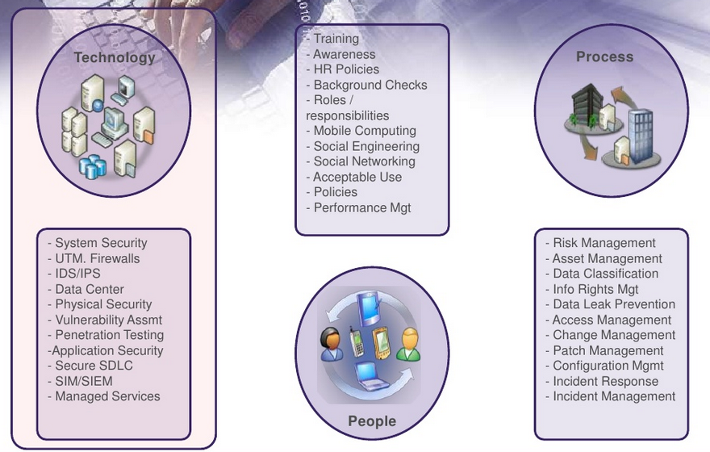
Appendix - How to Implement & Apply Security?
Security Elements
Notes:
16

Slide 17
Appendix - How to Implement & Apply Security?
SECURITY AREAS
Buildings, electric, waste, cleaning
Access to restricted areas
Fire, Water damage
Off-site facility
Hiring
Transfer
Termination
Network (LAN, WAN)
User authentication
Data access privileges
Antivirus, Hackers
Licenses
Security features
Physical
& Environmental
Security
Personnel
Security
Computer &
Communication
Operation
Security
RESPONSIBLE BY
Admin
HR
IT
Program/
Project/
Department
Employees

Slide 18
Appendix - How to Implement & Apply Security?
Information Security Policy
Roles & Responsibilities
HR Policies & Regulations
Admin Policies & Regulations
IT Policies & Guidelines
Software Policies
ISMS-STD-008-Information Security Manual.pdf

Slide 19

Information Security Policy
Refer to:
ISMS-POL-001-Information Security Policy.pdf
Notes:
19

Slide 20
Roles & Responsibilities (1/2)
ISMS Manager
Lead strategic actions for establishing and maintenance of ISMS (policies, standards, procedures, templates) across all business units
Address severe security incidents and violations escalated from business units.
Leads or commissions activities relating to contingency planning, business continuity management and IT disaster recovery in conjunction with relevant functions and third parties
Site Manager
Ensure safeguard of physical assets of responsible site
Ensure implementation of measures for business continuity and disaster recovery in the responsible site
Be the main contact point with external authorities related to site operation.
Notes:
20

Slide 21
Roles & Responsibilities (2/2)
Heads of Business Units (Admin, HR, IT, Executive Management Team, Project Managers)
Cooperate with ISMS Manager to develop and maintain ISMS, with area of responsible operations
First-level contact to address incidents and breaches reported by staff, and escalate the unresolved incidents to ISMS Manager
Cooperate with ISMS Manager in the cross-unit activities related to ISMS.
All employees (full-time, part-time)
Follow the ISMS policies, procedures, standards, regulations…
Abide Non-disclosure Agreement and Individual Agreement
Apply the best practices
Proactive on security matters
Timely report the security incidents and non-conformity
Contribute ideas to make security better
Notes:
21

Slide 22
ISMS Policies & Regulations (1/3)
Confidential information
All employees and partners are mandatory to sign NDA and Individual Security Agreements
Employees are prohibited from using or disclosing Confidential Information to any person, company, corporation, association or other entity for any reason or purpose whatsoever during or after the term of their employment with S3, except as required in the course of their employment in furtherance of S3 interests
Any documents classified as Confidential Information cannot be taken out of company without prior approval of employee’s direct manager. If you are not certain whether some information is confidential or not, get a confirmation from your manager
ISMS-POL-011-Confidentiality Management Policy.pdf

Slide 23
ISMS Policies & Regulations (2/3)
Confidential information (cont.)
Employees are expected to exercise utmost precautions when sharing Confidential Information with others within the company. As a general rule, employees should ONLY share Confidential Information with those who need to know. You may be held responsible collaterally for your sharing of Confidential Information that leads to eventual violations
Confidential Information can be in handwritten, printed, electronic, verbal or any other formats
ISMS-POL-011-Confidentiality Management Policy.pdf

Slide 24
ISMS Policies & Regulations (3/3)
Confidential information (cont.)
"Confidential Information" refers to information such as:
business and financial records, creations, data, information, know-how, processes, designs, techniques, technical plans, documentation, client lists, customer information, price lists, supplier lists, compensation data, labor relations strategies, pending projects and proposals, confidential planning or policy matters, and any operational, management, financial, accounting, control system, computer software, and databases, marketing or tax information relating to the business of S3 or its clients,
or such other information as may be designated by S3 as confidential
Violation of Confidentiality Management Policy is subjected to severe disciplinary actions
ISMS-POL-011-Confidentiality Management Policy.pdf

Slide 25
Admin Policies & Regulations (1/5)
Working Environment Discipline
Only smoke in designated areas
Do not possess, sell, purchase and use of alcohol or illegal, dangerous or restricted drugs / substances in the company
Do not possess or carry weapons, inflammable substances or explosives within the company premises
Only discuss company business with people outside the company on a need-to-know basis
Do not abuse your authority
Limit of food & beverage
ADM-STD-086-Building Safety Standards.pdf

Slide 26
Admin Policies & Regulations (2/5)
Receiving Guests
Declare personal belongings if any
Fill information in the Visitor Log Book at reception
Give guest a visitor badge. Guests are required to wear the badge during the visit
Never permit guest go into working area without being escorted by an S3 staff
Personal guests are not allowed to enter the office
Only Board of manager has a right to host guests in working area
ADM-WRK-057-Reception Area Instruction.pdf
Notes:
26

Slide 27
Admin Policies & Regulations (3/5)
Employee Check in/ out
Always use your own individual badge to get in/out the working area (not borrow/ use others’ badge)
Shut the door when you enter to any room in the company. Do not enter restricted areas and other restricted access project rooms without responsibility
Always wear the employee badge in the office
In case of forgetting your badge at home, you can borrow a temporary badge at receptionist desk (and return it back at the end of the day).
In case badge is lost, inform the HR department then a new one will be issued for a small fee
Check in/ out by security guard when required
Notes:
27

Slide 28
Admin Policies & Regulations (4/5)
Physical Environment Security
Facilities
Keep the desk clean and tidy
For upgrading or supplying any part of hardware, please contact IT for further information
Do not abuse working telephone/ printer/ fax to personal purpose. Any inter-province, international or mobile call for personal reason will be paid by the employees
TURN OFF the air-condition., light, fan, your PCs/Server, monitors, printers and whatever computing devices which does not really need to run 24/24 before going home from work
Notes:
28

Slide 29
Admin Policies & Regulations (5/5)
Physical & Environmental Security
Fire safety
When you hear the Fire Alarm all employees not involved in fighting the fire are to leave their room for the evacuation route and assemble in the front area
Cut off power in the area of fire
Get fire extinguishers
Move company’s property out of the fire area
If the fire is out of control, call The City Fire Department at 114
Move injured person (if any) out to the safe area or if it’s serious injury, call 115. First Aid Kits are available at exit door on the ground floor
Way of using fire extinguisher:
Shake a “Fire extinguisher” strongly
Pull safe button out
Aim to the fire and press a trigger of fire extinguisher
Notes:
29

Slide 30
IT Regulations (1/13)
Asset and Equipment Security (1/2)
Company/ Employees Property (cont.)
Exercise care to safeguard the valuable electronic equipment assigned to you by avoiding expose hardware, removable media to environmental hazards, such as food, smoke, liquids, high or low humidity, and extreme heat or cold. Employees who neglect this duty may be accountable for any loss or damage that may result
Employees are not allowed to perform installations, removal, disconnections, modifications, and relocations equipment without approvals by managers. Every computer main unit in S3 has a sealed stamp, that must not be broken without permission from IT Manager
Employees shall not take any company property including equipment and removable media out of the company without the informing their department manager about what equipment is leaving, what data is on it, and for what purpose
IT-STD-094-Equipment Security Standards.pdf
Notes:
30

Slide 31
IT Regulations (2/13)
Asset and Equipment Security (2/2)
Company/ Employees Property (cont.)
Removable media should be stored out of sight when not in use. If they contain highly sensitive or confidential data, they must be locked up. If they need to be disposed, wipe and dispose thoroughly
When confidential documentations on papers need to be disposed, they must be shredded using shredder
Employees must report to direct manager or ISMS Manager about any observed violations, theft, vandalism, sabotage, breach of security, lost identification badge…
In case there is any request for equipment installations, removal or relocation, the employee would ask for S3 IT group to carry out the tasks
Personal camera (camera, equipment with camera) is not allow to take photo or record video without manager approval in office
IT-POL-032-Media Handling Policy.pdf
Notes:
31

Slide 32
IT Regulations (3/13)
Privacy
Privacy information must not securely managed within S3 information system.
Data Security
Confidential information is forbidden to be sent/brought outside the company without approval
Project source code, documents, artifacts, etc.
IT/Network topology, company documents, customer information, etc.
Must not access data other than his/her own without authorization
Follow backup standards
ISMS-POL-115-Privacy Protection Policy.pdf
IT-STD-077-Information Backup Standards.pdf
Notes:
32

Slide 33
IT Regulations (4/13)
Mobile Device Security
Personal Removable Media/storage (USB, SSD, HDD, CD-R, DVD, cartridge, etc) and Mobile Device (laptops/tablet/phablet) are forbidden to use in S3 premise without approval
PC/Laptop/Tablet Usage
Screen saver with password lock on
Lock the devices when you sit out
Company PCs/Laptops/Tablets are forbidden to open, take out or change any components inside without approval
Devices are not joined domain are not allowed to access company network and internet without approval.
IT-POL-003-Mobile Device Policy.pdf
IT-STD-094-Equipment Security Standards.pdf
Notes:
33

Slide 34
IT Regulations (5/13)
Virus and Malicious Software, and unauthorized software
Update the Antivirus weekly
Do not yourself change or remove any option/configuration of antivirus or security software installed by IT
Only approved OS/Software/application (refer in IT-STD-136-Software Provision Standard) or project’s approved software are allowed
Immediately disconnect from all of the network and inform IT right away when there is virus detected or suspected by some ways in the machines.
Other Policies
Removing label stamped on the devices are forbidden, unless with IT Manager’s approval
Devices to bring in/out premise must have labels provided by IT
IT-STD-030-Software Usage Standard.pdf
Notes:
Malicious: intended to harm or upset other people
34

Slide 35
IT Regulations (6/13)
Email Policy
Email exchange is provided to facilitate communication between S3 employees & external correspondents for business purpose. It is strictly prohibited to:
Send or forward e-mail containing libelous, defamatory, offensive, racist or obscene remarks. If you receive an e-mail of this nature, you must promptly notify your supervisor
Conduct a personal business using company resources
Forge or attempt to forge e-mail messages
Send e-mail messages using another person’s e-mail account
Expose confidential information regarding S3 business or customer’s project information out to other non-related recipients without permissions from the appropriate S3 authority
Notes:
Libelous: a piece of writing which contains bad and false things about a person
Defamatory: to damage the reputation of a person
Forge: gia mao email
35

Slide 36
IT Regulations (7/13)
Email Policy (cont.)
S3 allows the reasonable use of e-mail for personal use if certain guidelines are adhered:
Personal use of e-mail should not interfere with work
Personal e-mail must also adhere to the guidelines
The forwarding of chain letters, junk mail, jokes and executable is strictly forbidden
Do not send mass mailings without approval
IT-STD-034-Email Usage Standard.pdf

Slide 37
IT Regulations (8/13)
Internet Policies (cont.)
Unnecessary or unauthorized Internet usage can cause network congestion and expose security risks, affect S3 and customers.
Unlawful Internet usage may also garner negative publicity for the company and expose S3 to significant legal liabilities. Thus ensuring this security must be everyone’s first concern.
Internet connections are provided for business related activities only. The following table summarizes the activities employee can and cannot do:
IT-STD-025-Internet Usage Standard.pdf
Notes:
37

Slide 38
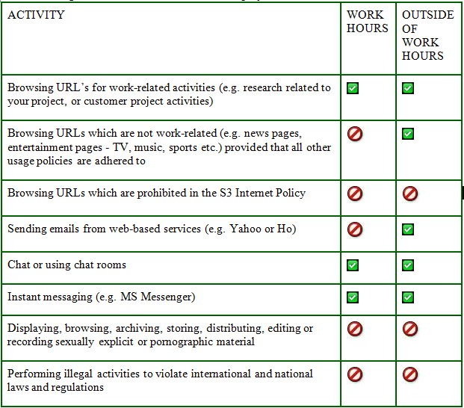
IT Regulations (9/13)

Slide 39
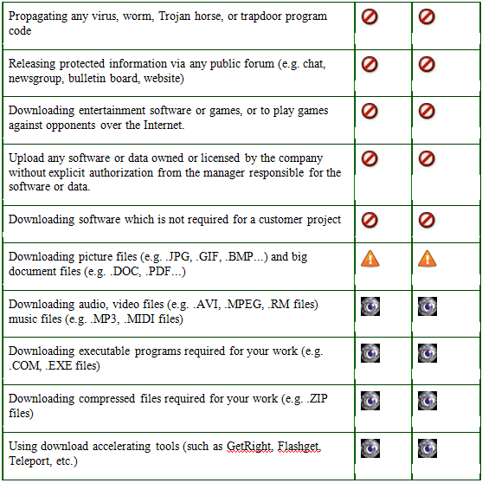
IT Policies (10/13)
Internet Policies (cont.):
Notes:
39

Slide 40
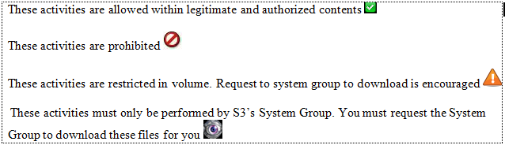
IT Regulations (11/13)
Internet Policies (cont.)
S3 allows the reasonable use the Internet for personal use if certain guidelines are adhered to:
Personal use of the Internet should not interfere with work
Personal Internet use must also adhere to the guidelines in this policy
Notes:
40

Slide 41
IT Regulations (12/13)
Passwords
Employees must ensure that the passwords:
be distributed on a need-to-know basis
be created by random characters in nature
do not reflect proper names and dictionary text
must be a combination of special, alpha and numeric characters
contain no less than nine characters in length
be changed at least every 30 days
not to be used in any automatic log-on processes
Keep the passwords confidential
Not write the password down to any media that may be accessed by others

Slide 42
IT Regulations (13/13)
Network, servers and Computer security
The following rules must be followed
Always ensure that the workstation has been set to have screen-saver with password lock on, or auto-log off mechanism, that will be activated after a pre-determined time of inactivity.
Always ensure that antivirus software has been installed and enabled. Employee must update the virus list regularly follow the notices from System group.
Inform system right away when there is virus detected or suspected by some ways in the machines.
Must not access data other than his/her own without authorization
Must not use any communication test equipment and/or software for controlling and/or monitoring the network system without authorization from the managers
IT-STD-043-Wireless Access Standard.pdf
IT-STD-085-Network Control Standards.pdf

Slide 43
Software Policies
Ownership of Work Product
Confidentiality and Warranty
Software Development

Slide 44
Ownership
All of “Work Product” from software outsourcing services shall be considered as “work-make-for-hire” including
Work product: software, procedure, source code, document, data, specification, product, innovation, know-how, plan, procedure, report, etc
IP rights: patent, patent application, copyright, trade secret, trade made, other intellectual property and proprietary rights
No Use of other IP rights
Do not include or embed or use any IP rights of company or third party without consent of customer
Notes:
44

Slide 45
Confidentiality & Warranty
Only disclose the confidential information to reasonable person/party “need to know” who have agreed to receive confidential information including
All technical/non-technical information, license, proposal, product, service
Software, technology, research, purchasing, manufacturing, customer list, business forecast, plan, etc
Hold all confidential information in secure environment
Warranty our services are provided in professional and workmanlike manners
All “Work Product” does not and shall not infringe any third party’s IP rights
All “Work Product” does not contain any viruses, trap doors, back doors or other such code
ISMS-POL-110-Intellectual Properties Protection Policy.pdf
Notes:
45

Slide 46
Software Development
Development of software and systems (either by in-house S3 developers or contractors) to be used by S3 operations shall ensure adequate security features are fully implemented and tested
Architecture and design of applications to be used by S3 operations shall abide to Design Principles that ensure
IT-STD-087-Business Application Development Standards.pdf
IT-STD-088-Business Application Design Principles.pdf
Notes:
46

Slide 47

Grow together
www.s3corp.com.vn

